Slide 1
Final Project - Customer Churn Analysis and Prediction
Student: Xiaolan Li
Professor: Wonjun Lee

Slide 2

Agenda
1. Introduction
2. Research Questions
3. Data Preprocessing
4. Data Exploration Analysis
Label data
Catagorical data
Numerical data
5. Building Model
Single model with default parameters
Single model with tuning parameters
Hibrid model
6. Conclusuion

Slide 3
Introduction
In this project, I’m going to explore the reason behind customer churn and predict who’s about to leave currently. This can help the company to maximize the customer experience for preventing customer attrition. Therefore, it can help companies reduce losses and even increase the number of customers to increase profits. Additionally, this can be applied in every company, with a high impact value.

Slide 4
Research Questions
- Q1: Which services should company improve to avoid current customer leaving?
- Q2: What kind of services are more related to whether a customer leave?
- Q3: Who are more likely to leave and what the confidence of that predictions are?

Slide 5
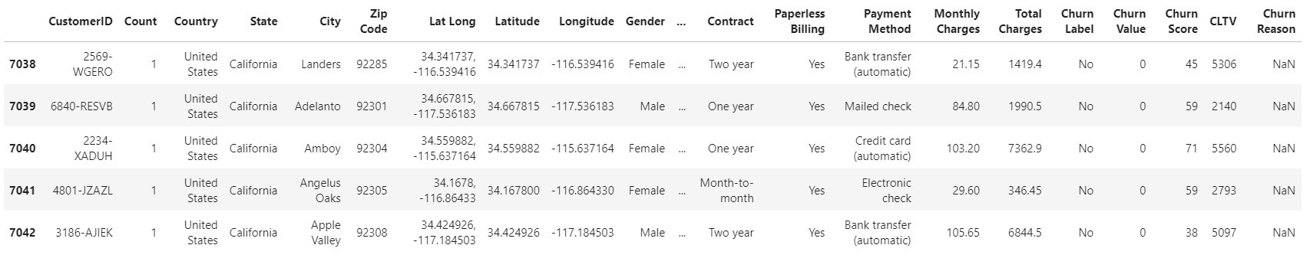
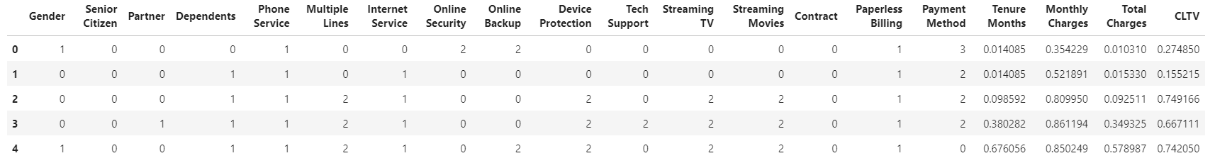
Data Preprocessing
Original Dataset: 33 columns and 7043 observations
Cleaned Dataset: 20 features, 1 label and 7032 observations
(Dropna, Drop columns, Label Encoding Cat, MinMax Scaler Numeric)

Slide 6
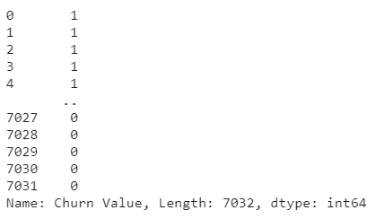
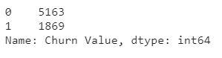
EDA - Label

Slide 7
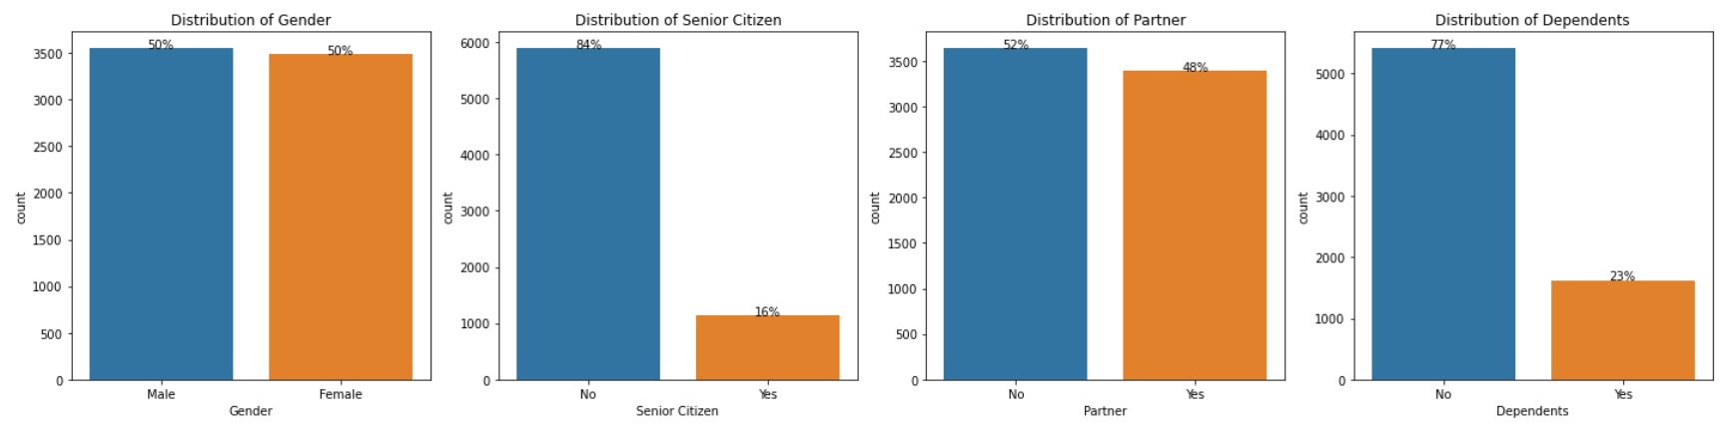
EDA - Catogorial Data
Demographic_group：
Equal distribution in Gender, and almost equal in Partner
Most of our customers are not Senior Citizen, only 1/6 are Senior Citizen
2/3 of our customers are Economic independents and 1/3 of our customers are enconomic dependent

Slide 8
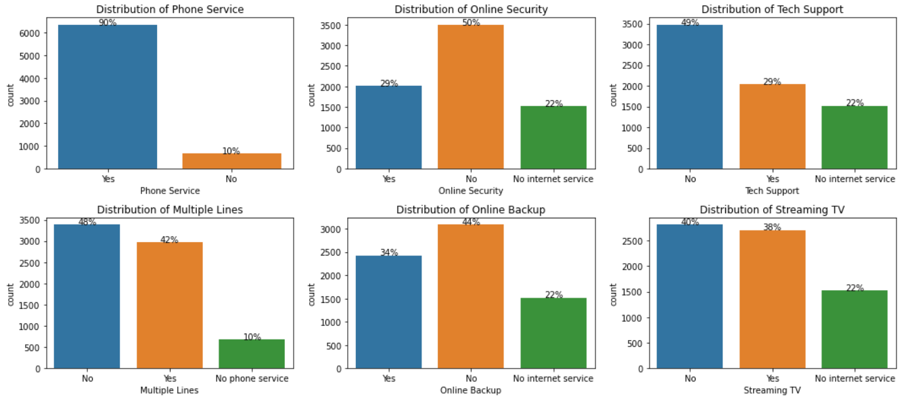
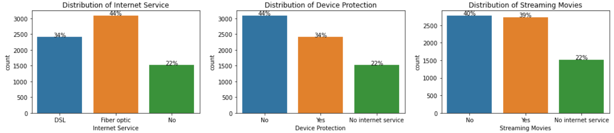
EDA - Catogorial Data
Services_group:
Most of our customers have used our Phone Services, among these customers, around 1/2 have Multiple Lines.
4/5 customers are using Internet Service, among these customers, around 1/3 have Online Security, Tech Support, around 1/2 have Online Backup, Device Protection, Streaming TV and Streaming Movies.

Slide 9
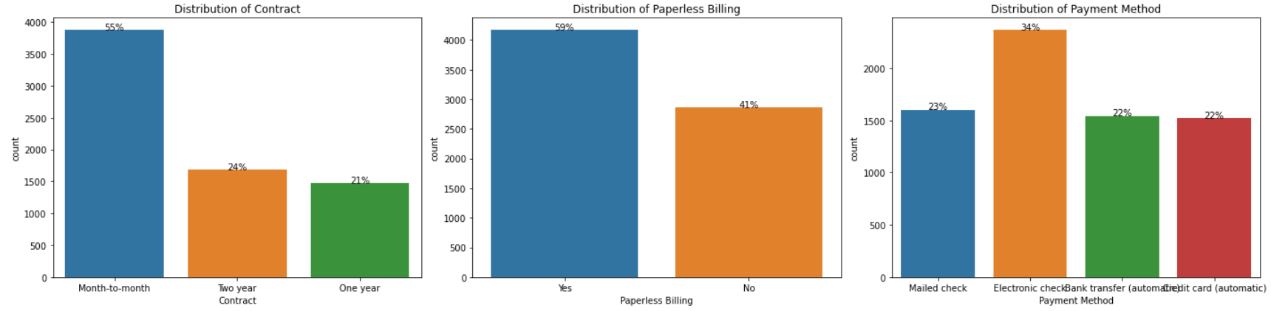
EDA - Catogorial Data
Customer_account_group：
Around 1/2 customers signed month-to-month Contract with us.
More customers are using Paperless Billing.
More customers are going to pay with Electronic check.

Slide 10
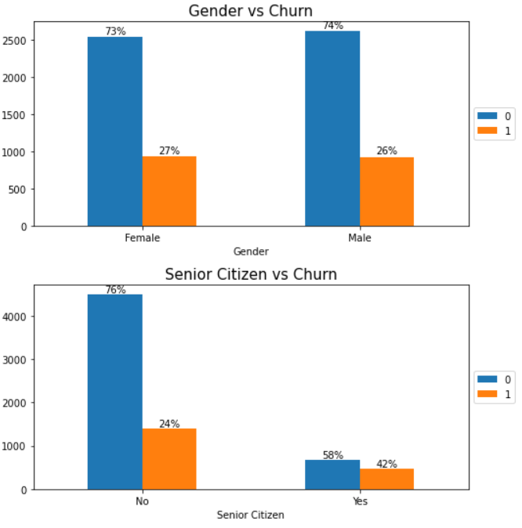
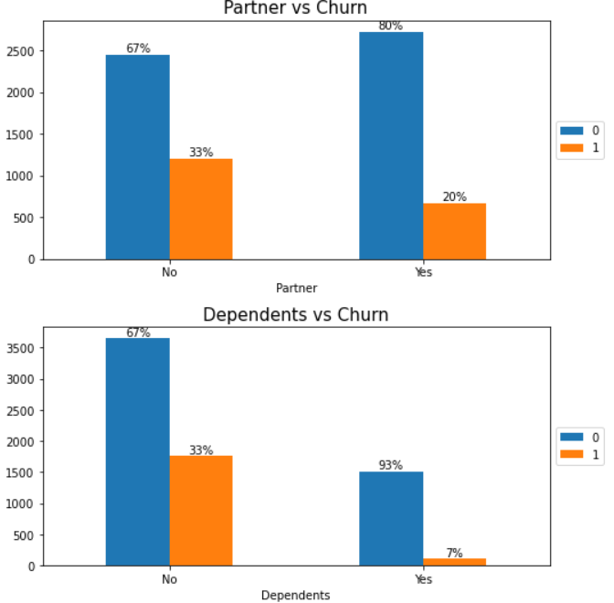
Catogorial Data vs Churn
Demographic info：
Gender is quite balanced in either churn or not. Thus Gender might not be a feature to affect the churn directly.
Senior Citizen have a much higher churn rate
Customers without Partner or Dependents are more likely to leave.

Slide 11
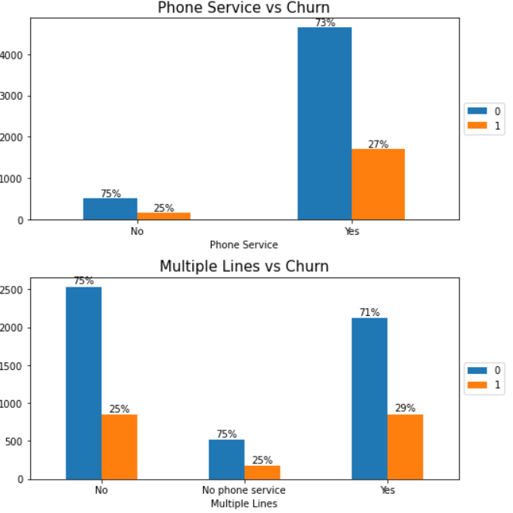
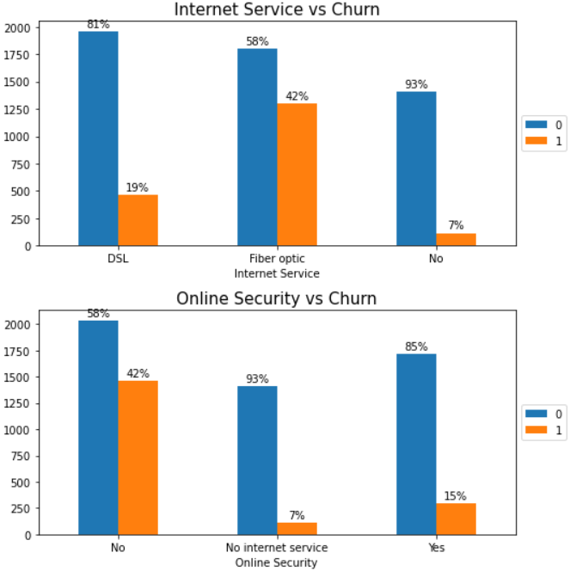
Catogorial Data vs Churn
Services：
Gender is quite balanced in either churn or not. Thus Gender might not be a feature to affect the churn directly.
Senior Citizen have a much higher churn rate
Customers without Partner or Dependents are more likely to leave.

Slide 12
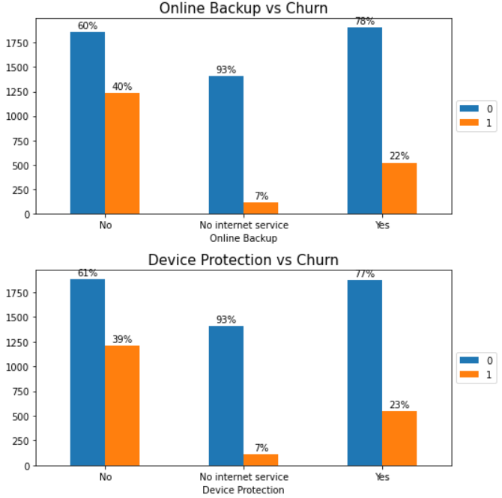
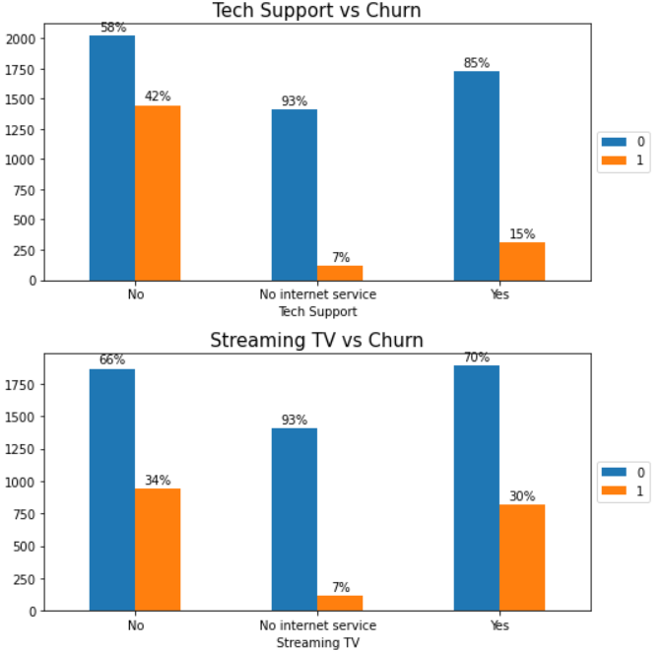
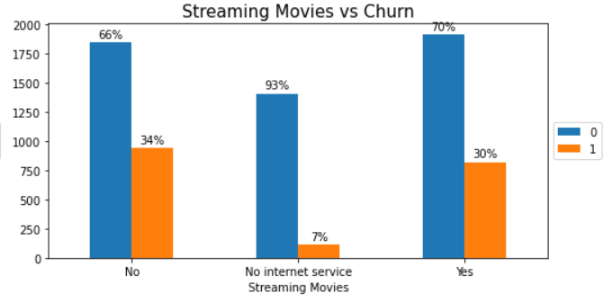
Catogorial Data vs Churn
Services：
Customers with Fiber optic Internet Service are very likely to churn.
Customers who doesn't sign up for Online Security/Online Backup/Device Protection/Tech Support are very likely to churn.
Streaming TV and Streaming Movies are the most used service, but they're also the service with the highest customer churn rate.

Slide 13
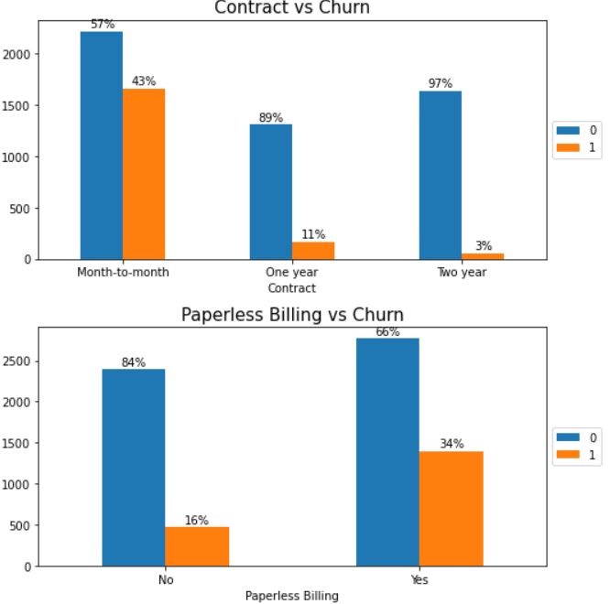
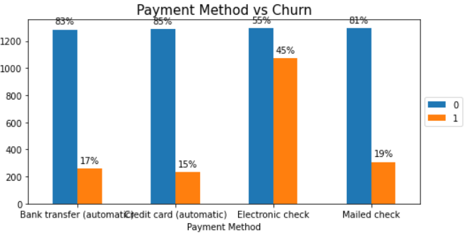
Catogorial Data vs Churn
Customer account info：
Customers with Paperless Billing/using Electronic check Payment Method are very likely to churn.
The shorter the Contract, the higher the customer churn rate.

Slide 14
Q1. Which services should company improve to avoid current customer leaving?
Solution1
The company could ……
Improve the Fiber optic technology and provide more DLS Internet Service advertisement currently.
Provide some bonus or discount to those senior citizen.
Encourage customers to sign up for Online Security/Online Backup/Device Protection/Tech Support .
Provide payment by installments program suggestions to those customers.
Suggest to customers to use credit card automatic as a default payment method that has lowest churn rate.
Encourage customer to subscribe with years such as using high discount or adding bonus package.

Slide 15
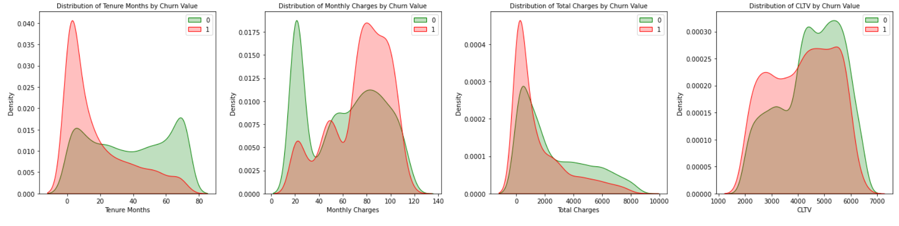
Numerical Data vs Churn
Conclusion:
Tenure Months: Peak - Churn: around 5 months. There is a trend that the larger the tenure, the smaller the churn rate.
Monthly Charges: Peak - Churn: around 80 dollars ; Not Churn: around 20 dollars. The churn rate and monthly charges are not clearly related to each other.
Total Charges: There is a trend that the larger the TotalCharges, the smaller the churn rate.
CLTV: The churn rate and monthly charges are not clearly related to each other.

Slide 16
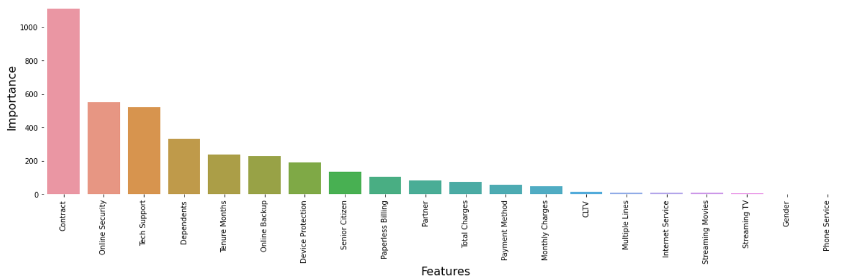
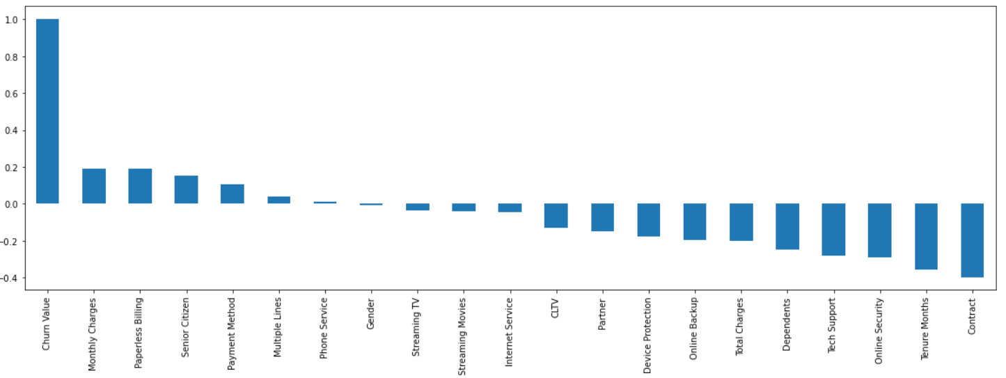
Q2. What kind of services are more related to whether a customer leave?
Online security, Tenure Month, Dependent and Tech support

Slide 17
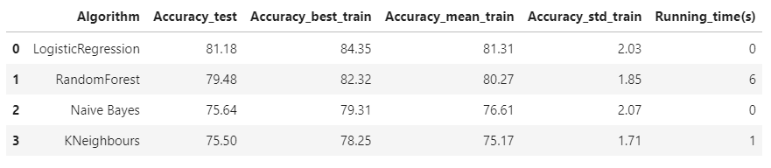
Building Model
1. Single Model for all features with Default Parameters
LogisticRegression, RandomForest, Naive Bayes, and KNeighbours
10 fold cross validation
Logistic regression has a best performance

Slide 18
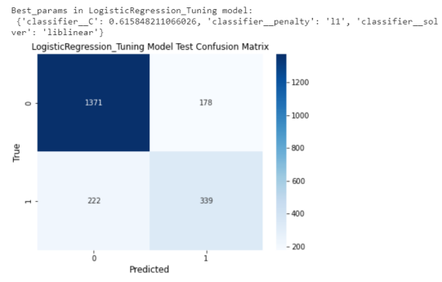
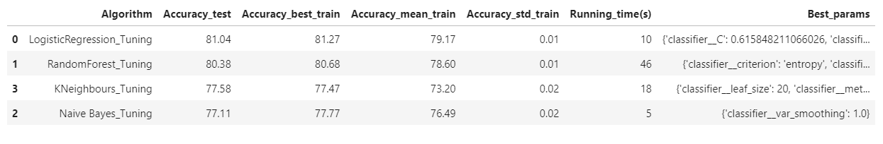
Building Model
2. Single Model for all features with Tuning Parameters
LogisticRegression, RandomForest, Naive Bayes, and KNeighbours
Pipeline with minmax scaler as the first step and used grid search
10 stratified fold cross validation
Logistic regression has a best performance
Score in Random Forest, KNeighbours
and Naive Bayes has been improved
Standard error of score are quite low

Slide 19
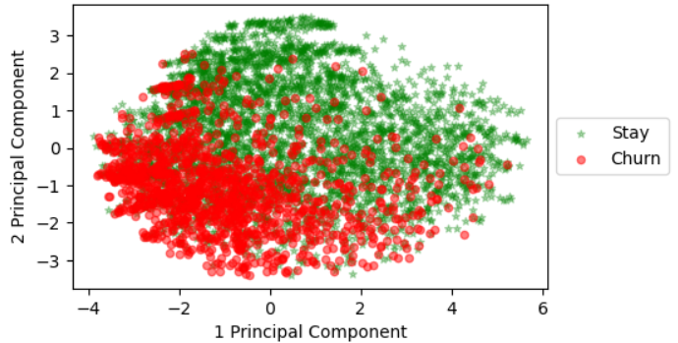
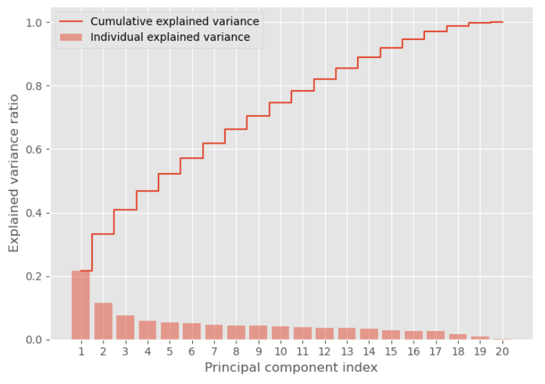
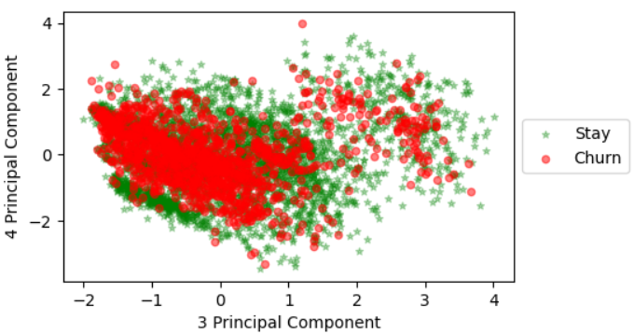
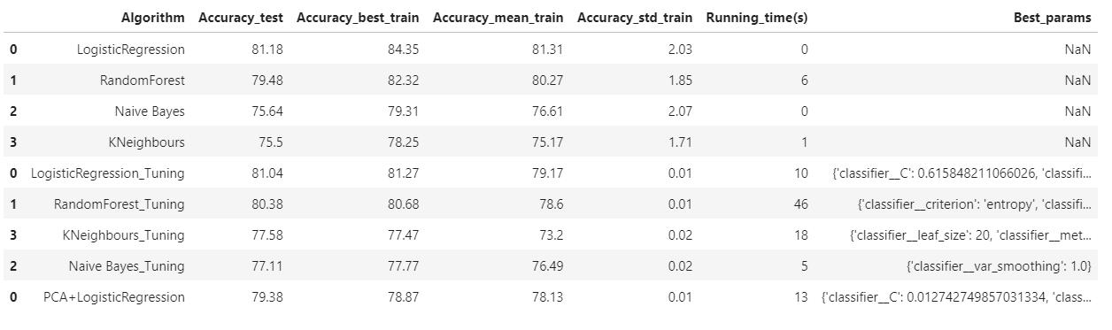
Building Model
3. Hybrid Model : PCA, Logistic Regression with Tuning Parameters

Slide 20
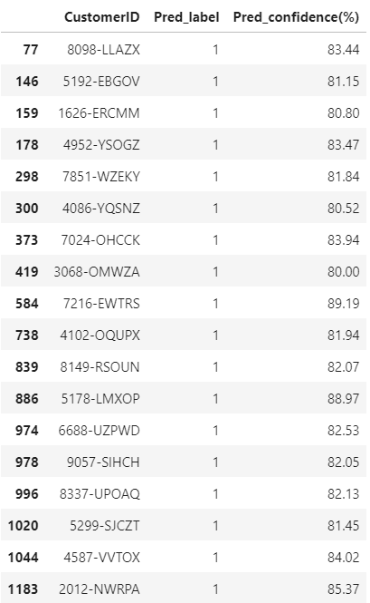
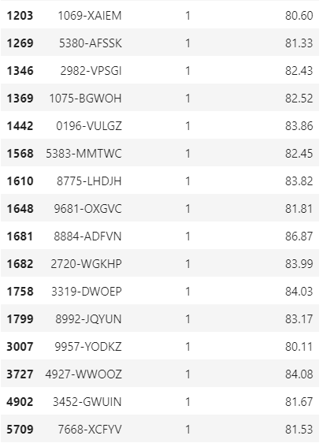
Q3. Who are more likely to leave and what the confidence of that predictions are?
There are 2110 customers currently in the test dataset.
There are 517 (24%) customers might be churn,
34 customers among of them have more than 80% confidence that more likely to churn.

Slide 21
Conclusion
Based on the solutions of those questions, the company are now able to make some relevant strategies to improve their services and knowing who are more likely to leave now thus this research can help company reduce the churn rate of their customers to increase the profit.

Slide 22
Reference
https://www.sciencedirect.com/science/article/abs/pii/S0148296321000308
https://content.iospress.com/articles/journal-of-intelligent-and-fuzzy-systems/ifs190677
https://stackoverflow.com/questions/31749448/how-to-add-percentages-on-top-of-bars-in-seaborn
https://stackoverflow.com/questions/45969390/difference-between-stratifiedkfold-and-stratifiedshufflesplit-in-sklearn
https://towardsdatascience.com/gridsearchcv-for-beginners-db48a90114ee
https://joannaoyzl.github.io/2019/07/28/Unsupervised-Learning-in-Python/

